Slide 1
Smart Relection
Manoj Khatri, Zoya Sheik, Karishma Garikapalli

Slide 2
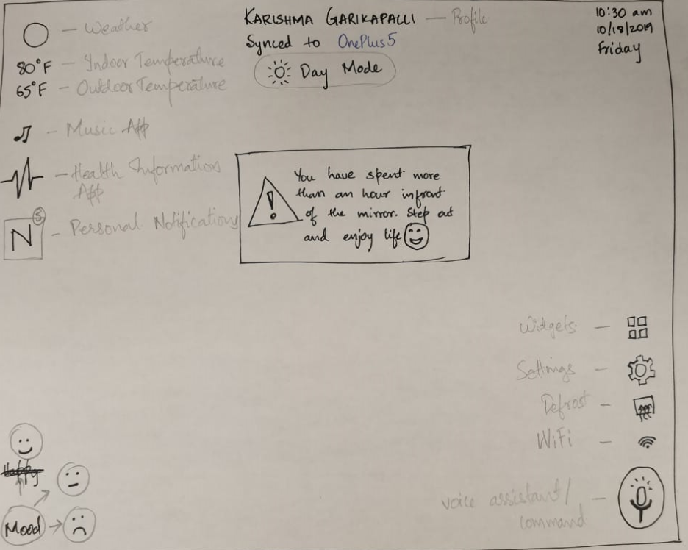

Slide 3
Login
We plan on using facial recognition algorithm to sign users in, to their profiles
For this proof of concept algorithm so we assume the users have already registered and profile is created

Slide 4
Features
Facial Recognition
Moods
Temperature, Date and Weather info
Music
Personal Notifications

